Slide 1
ITE442 FINAL PROJECT CLINIC APPOINTMENT SYSTEM
JUSTIN Himarua 1902150006
ALEXANDER VIETEN 1903070008
KIMSENG HOUY 1809170001

Slide 2
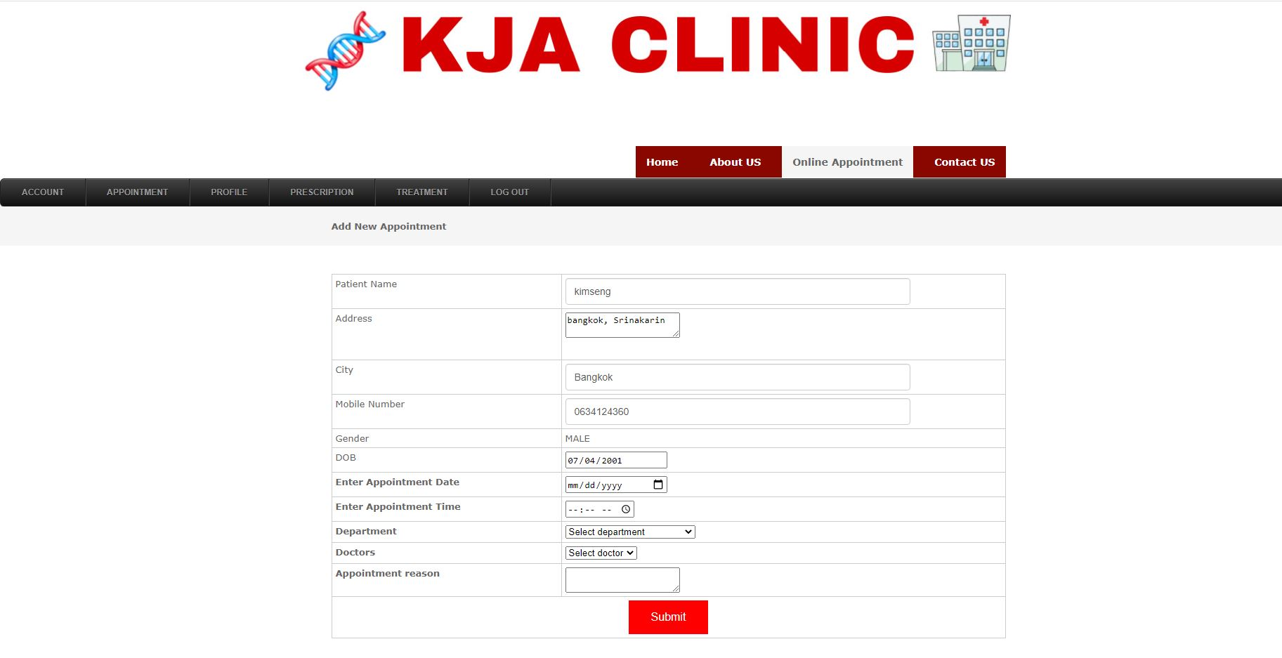
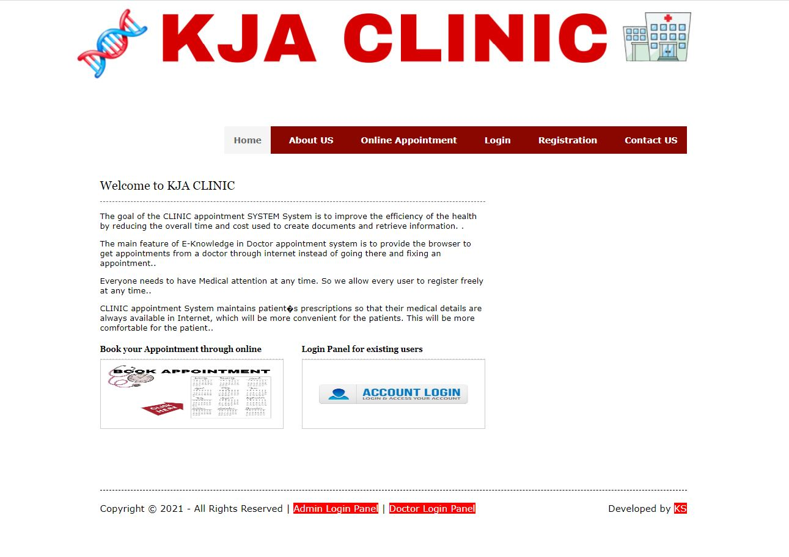
OUR DEMO

Slide 3

How did we implement it?
- First, we create the ER diagram
- Create the relationship diagram
- Do some normalization
- Create the web application

Slide 4
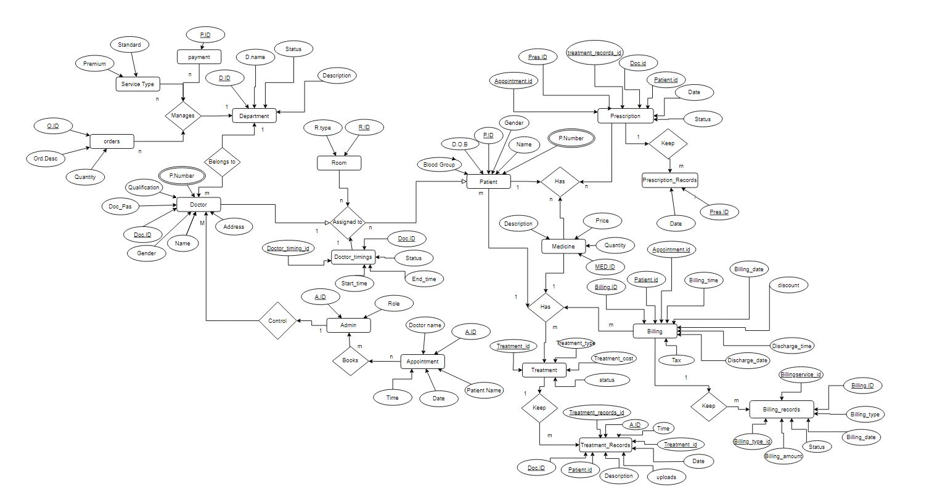
ER Diagram

Slide 5
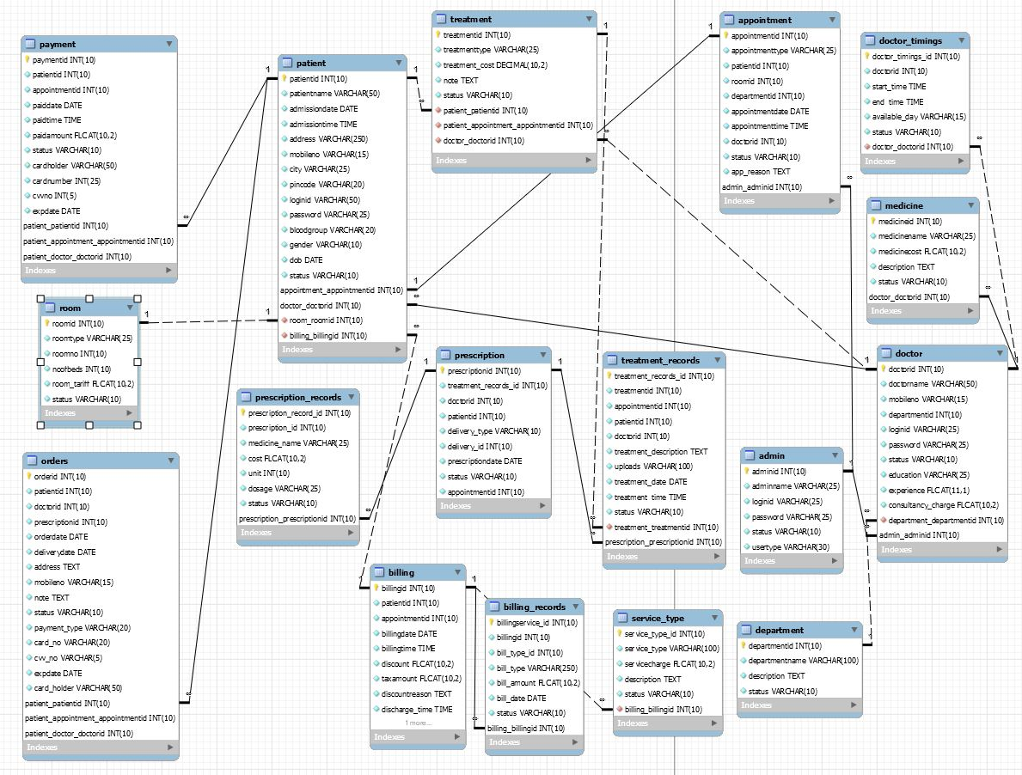
UML

Slide 6
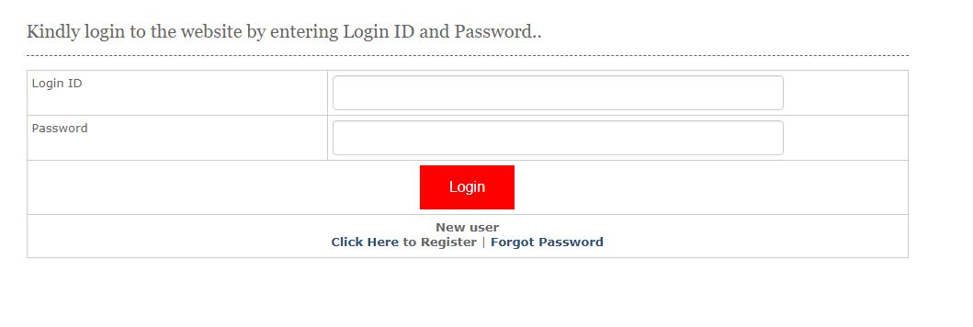
if(isset($_SESSION[patientid]))
{
echo "<script>window.location='patientaccount.php';</script>";
}
if(isset($_POST[submit]))
{
$sql = "SELECT * FROM patient WHERE loginid='$_POST[loginid]' AND password='$_POST[password]' AND status='Active'";
$qsql = mysqli_query($con,$sql);
if(mysqli_num_rows($qsql) >= 1)
{
$rslogin = mysqli_fetch_array($qsql);
$_SESSION[patientid]= $rslogin[patientid] ;
echo "<script>window.location='patientaccount.php';</script>";
}
else
{
echo "<script>alert('Invalid login id and password entered..'); </script>";
}
}
LOGIN

Slide 7
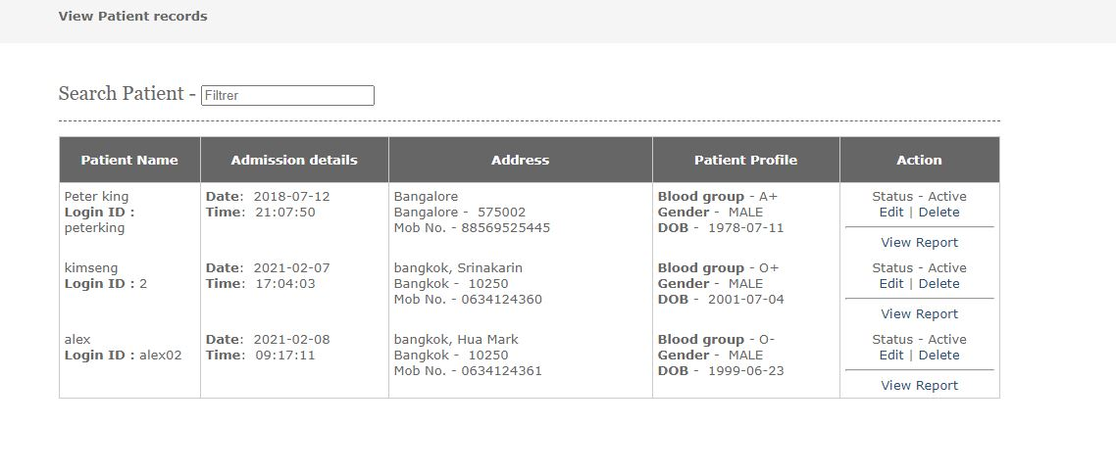
$sql ="SELECT * FROM patient";
$qsql = mysqli_query($con,$sql);
while($rs = mysqli_fetch_array($qsql))
{
echo "<tr>
<td>$rs[patientname]<br>
<strong>Login ID :</strong> $rs[loginid] </td>
<td>
<strong>Date</strong>: &nbsp;$rs[admissiondate]<br>
<strong>Time</strong>: &nbsp;$rs[admissiontime]</td>
<td>$rs[address]<br>$rs[city] - &nbsp;$rs[pincode]<br>
Mob No. - $rs[mobileno]</td>
<td><strong>Blood group</strong> - $rs[bloodgroup]<br>
<strong>Gender</strong> - &nbsp;$rs[gender]<br>
<strong>DOB</strong> - &nbsp;$rs[dob]</td>
<td align='center'>Status - $rs[status] <br>";
if(isset($_SESSION[adminid]))
{
echo "<a href='patient.php?editid=$rs[patientid]'>Edit</a> | <a href='viewpatient.php?delid=$rs[patientid]'>Delete</a> <hr>
<a href='patientreport.php?patientid=$rs[patientid]'>View Report</a>";
}
echo "</td></tr>";
}
View (Admin)
if(isset($_GET[delid]))
{
$sql ="DELETE FROM patient WHERE patientid='$_GET[delid]'";
$qsql=mysqli_query($con,$sql);
if(mysqli_affected_rows($con) == 1)
{
echo "<script>alert('patient record deleted successfully..');</script>";
}
}

Slide 8
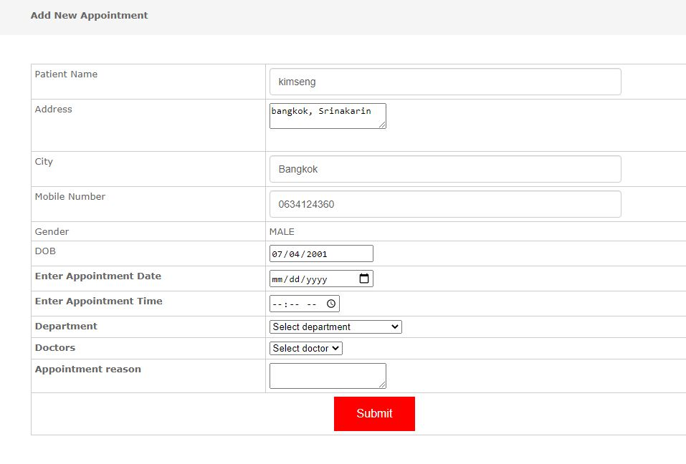
INSERT
$sql ="INSERT INTO appointment(appointmenttype,patientid,appointmentdate,appointmenttime,app_reason,status,departmentid,doctorid) values('ONLINE','$lastinsid','$_POST[appointmentdate]','$_POST[appointmenttime]','$_POST[app_reason]','Pending','$_POST[department]','$_POST[doct]')";

Slide 9
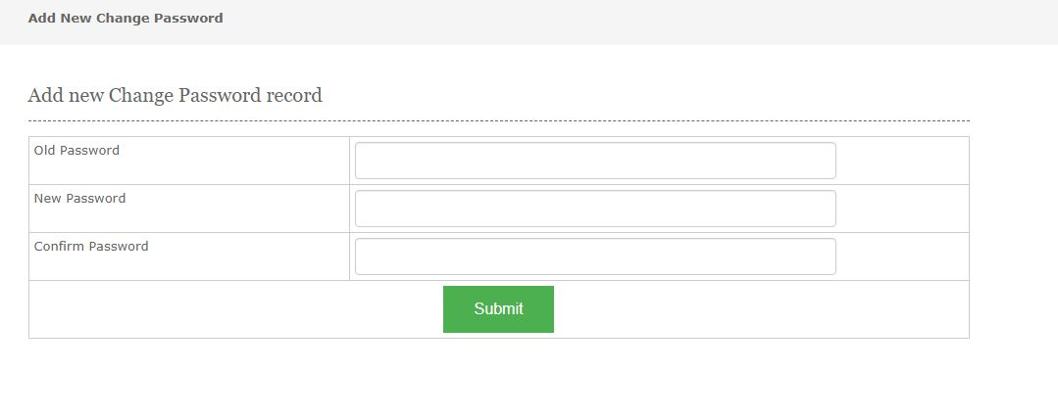
UPDATE/CHANGE
if(isset($_POST[submit]))
{
$sql = "UPDATE patient SET password='$_POST[newpassword]' WHERE password='$_POST[oldpassword]' AND patientid='$_SESSION[patientid]'";
$qsql= mysqli_query($con,$sql);
if(mysqli_affected_rows($con) == 1)
{
echo "<script>alert('Password has been updated successfully..');</script>";
}
else
{
echo "<script>alert('Failed to update password..');</script>";
}
}

Slide 10
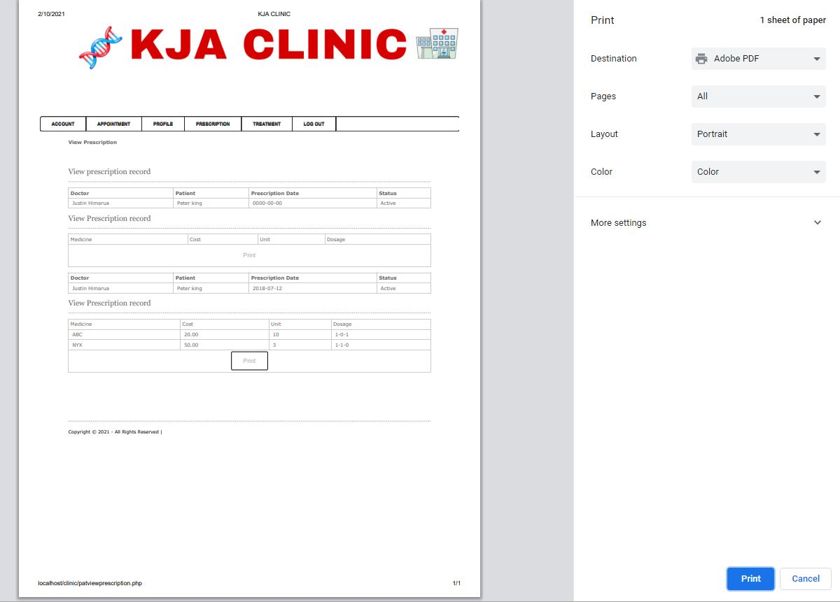
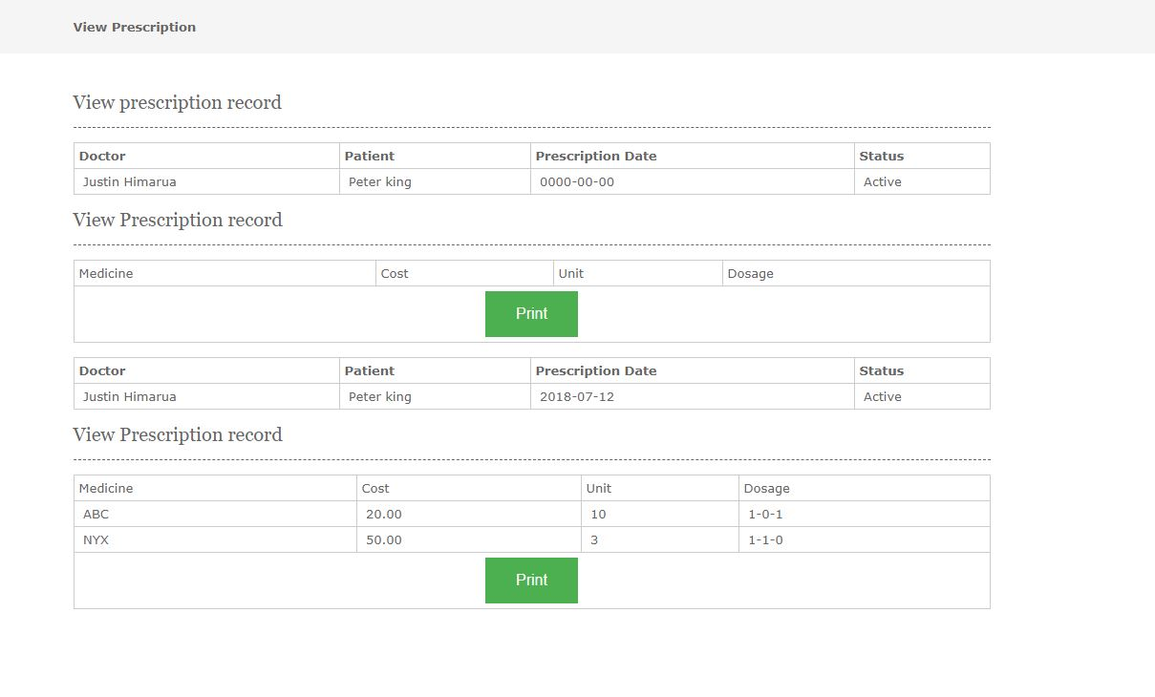
<script>
function myFunction()
{
window.print();
}
</script>
PRINT

Slide 11
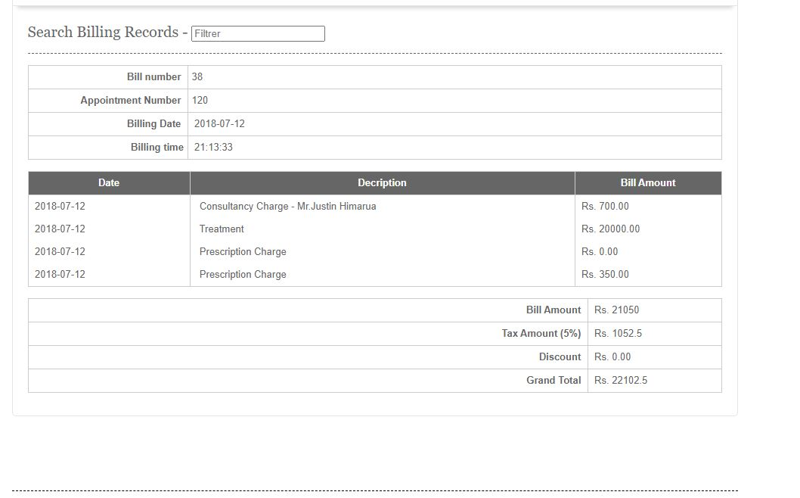
Further work (Pay Online)

Slide 12
FUTURE WORK
- Improve as required to be more perfect
- Implement new web interface
- Add Pay method that can pay online

Slide 13

THANK YOU!!!

